Slide 1

GAMBLING POLICY REVIEW
ELECTED MEMBER WORKSHOP
9 May 2023

Slide 2

Purpose
Present key points of current gambling situation and Policy
Hearing from guest speakers
Seeking direction on policy review options

Slide 3
Welcome to our guests
Problem Gambling Foundation
Kristy Kang and Kay Kristensen
Gaming Machine Association of New Zealand
Jarrod True
Te Tari Taiwhenua/ Department Of Internal Affairs
Sonia Christensen and Neove Christoforou

Slide 4
What this workshop will cover…
What the policy can/must cover (scope)
Current policy
Guest speakers
Policy options
Seeking direction on review

Slide 5
Class 4 Venue Policy
Council’s gambling policy must cover where and if Class 4 venues can be located within the district.
Council’s gambling policy may include:
restrictions on the maximum number of gaming machines at a Class 4 venue;
a relocation policy, which relates to setting out if and when consent will be granted where a venue is intended to relocate from an existing venue.

Slide 6
TAB Venue Policy
This policy must cover:
• If new TAB Venues can be located within the district;
• Where new TAB venues can be located within the district.

Slide 7
current policy
Absolute Cap at 232 gaming machines.
Relocation policy.
Primary activity of Class 4 venue is not allowed to be gambling.
TAB venues are not allowed to adjoin any school, or licensed early childhood centre.

Slide 8

Minimum Standards
The Gambling Act 2003 sets minimum restrictions
Maximum number of gaming machines
18 - if licence held before 17 October 2001
9 - if after this date
Merger allowed – no more than 30 gaming machines
Council controls location of venues

Slide 9



Relocation policy
Council currently has a relocation policy
A relocation policy allows conditions of existing licence to move to a new venue –
Same number of machines, same corporate society, no merging of conditions.
Allows venues in undesirable location to move to more suited location.
Sinking Lid

Slide 10

Absolute caps
Council currently has an absolute cap at 232
Shown to reduce number of gaming machines, venues and cumulative expenditure.
Uncertainty whether absolute caps reduce the number of problem gamblers.
Is a move towards a sinking lid but not completely.

Slide 11

Per capita caps
Limits number of gaming machines and venues in proportion to population.
Shown to reduce gaming machines and venues.
Increased use of gambling intervention services after implementation.
Sinking Lid

Slide 12
Sinking lid
A cap that decreases whenever venues lose their licences.
Shown to reduce gaming machine expenditure contemporaneously and in lagged years.

Slide 13
Guest presentations
5 Minutes each to speak
Elected Members please hold questions till the end of all presentations

Slide 14
Problem Gambling Foundation
Delivering gambling harm services

Slide 15

Waipa’s
Class 4 Gambling
In Waipa: $10.3 million was lost to pokies in 2022. Approximately $45.1k was lost on each pokie machine in the district. By comparison, residents in Waipa have a median income of $35.5k (2018 Census). This means a pokie machine made ~$9,600 more than the average person in the district.

Slide 16
Sinking Lid Policy
Recommend a sinking lid policy With no relocations or club mergers Why? Best policy that aligns with the Gambling Act’s public health approach to minimise gambling harm. Evidence that it reduces problem gambling expenditure by 13%. 33 out of 65 councils across NZ has adopted a sinking lid policy.

Slide 17
Gaming Machine Association of
New Zealand
Representing the gaming machine sector

Slide 18
The Current Policy is Reasonable
There is no new evidence or data to justify a policy change.
Changing the policy would be costly and time consuming.
Retaining the current policy will not result in any significant growth.
There are currently no venues in very high deprivation areas.
Local problem gambling presentations are falling. Only 1 new person from the Waipa District sought help in 2021/22.
The national problem gambling rate is very low: 0.2%.
In 2021, $1.29m in grants were made to Waipa organisations.
Plus benefit from 3 club venues and 1 TAB venue.
Plus benefit from regional and national grants.
There is no direct link between gaming machine numbers and problem gambling rates.
The closure of physical venues, does however, result in an increase in online gambling.

Slide 19
Gaming Machine Relocation
Venue relocation is a harm minimisation tool.
Venue relocation allows venues to move out of undesirable areas such as residential areas and high deprivation areas.
Not allowing relocation entrenches venues in undesirable areas.
Venue relocation is fair to local business owners.
Businesses can be restored following a fire, natural disaster, or public works acquisition.
Venue relocation protects community funding.
Without the ability to relocate, gaming machine funding could be dramatically and suddenly reduced as a result of a natural disaster such as an earthquake.
Relocation also allows venues to move:
  Out of earthquake prone buildings.
  To free up large blocks of land.
  When the landlord is demanding unreasonable rentals.
  To new, modern, refurbished premises.

Slide 20
te tari taiwhenua/ department of internal affairs
Class 4 regulators

Slide 21

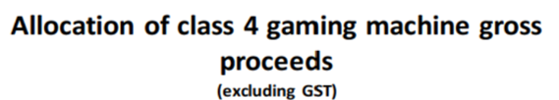
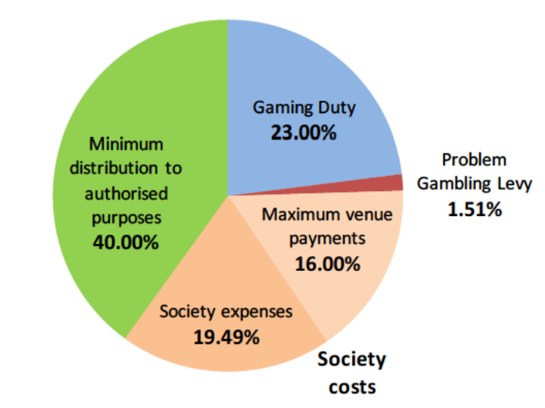
Pokie system at a glance
DIA’s Regulatory role in Class 4
Venue inspections
Licensing
Grant audits
Waipā District Council

Slide 22
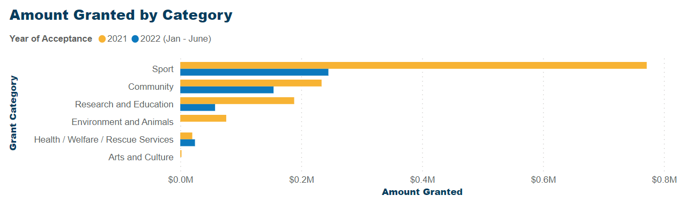
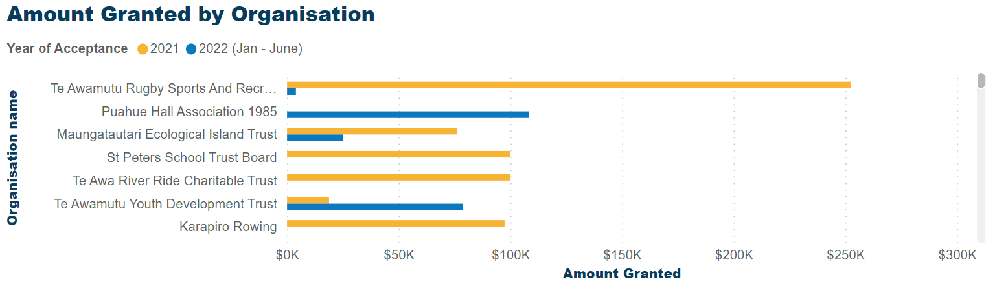

Gaming Machine Profits in Waipā: $10,706,196
Year end 31.03.23
Waipā District Council

Slide 23
Elected Members
Questions?

Slide 24
Policy review – Where to from here?
Current Policy
Keep Current Policy
Change Current Policy

Slide 25




Policy Change
Policy options for changing the current policy
Minimum Standards
Relocation Policy
Absolute Caps
Per Capita Caps
Sinking Lid

Slide 26
Thank you

